Slide 1
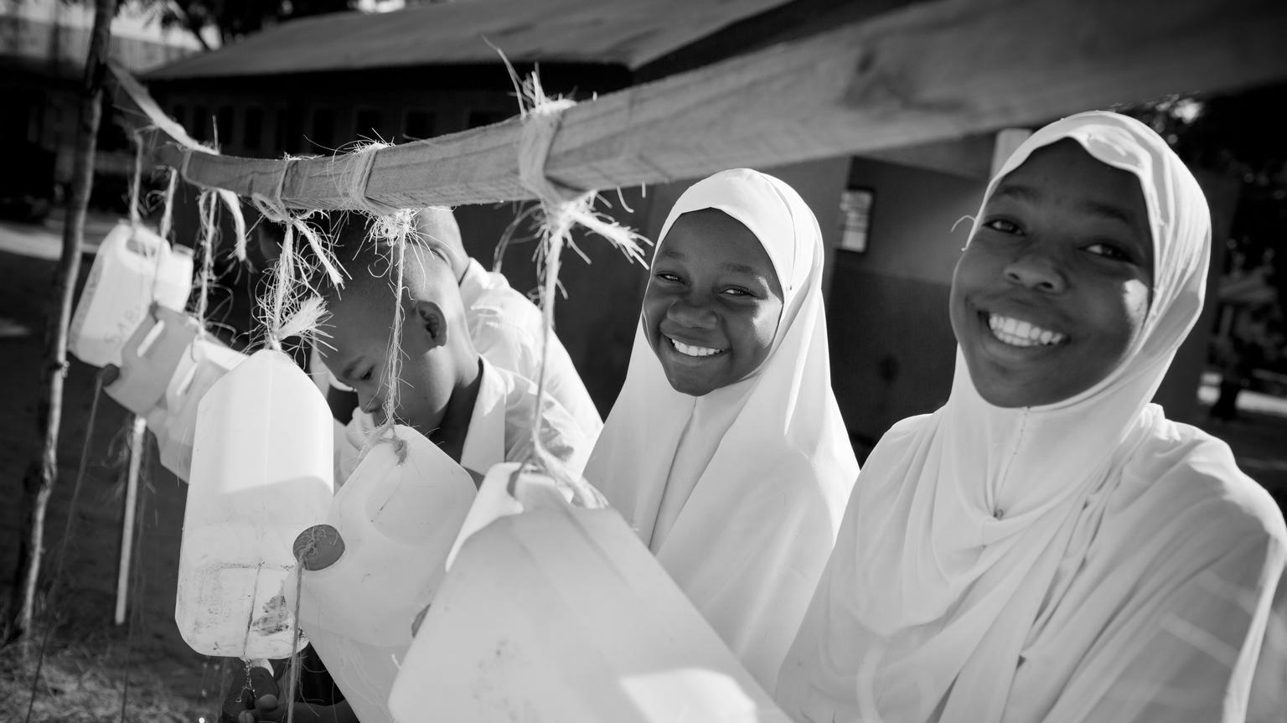

So much research, now how do we use it?
5 key lessons to ensure we do a better job of maximizing evidence uptake and impact to end child marriage and support women and girls
Manahil Siddiqi, MPH
Strategic Technical Assistance for Research (STAR) Initiative to end Harmful Practices
UNICEF Innocenti Office of Research and Foresight

Slide 2
Oftentimes we assume that if we communicate research, it will be used…

Slide 3
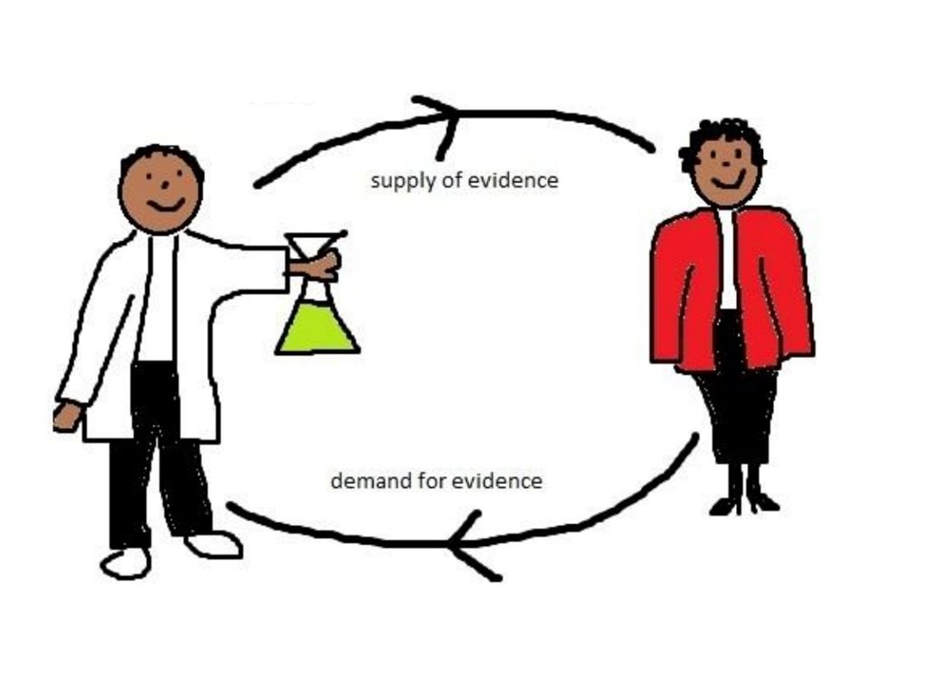

Evidence uptake
All the activities that facilitate and contribute to the adoption and utilization of evidence by researchers, practitioners, policymakers and other actors.
Research uptake activities aim to support both the supply of research and demand

Slide 4
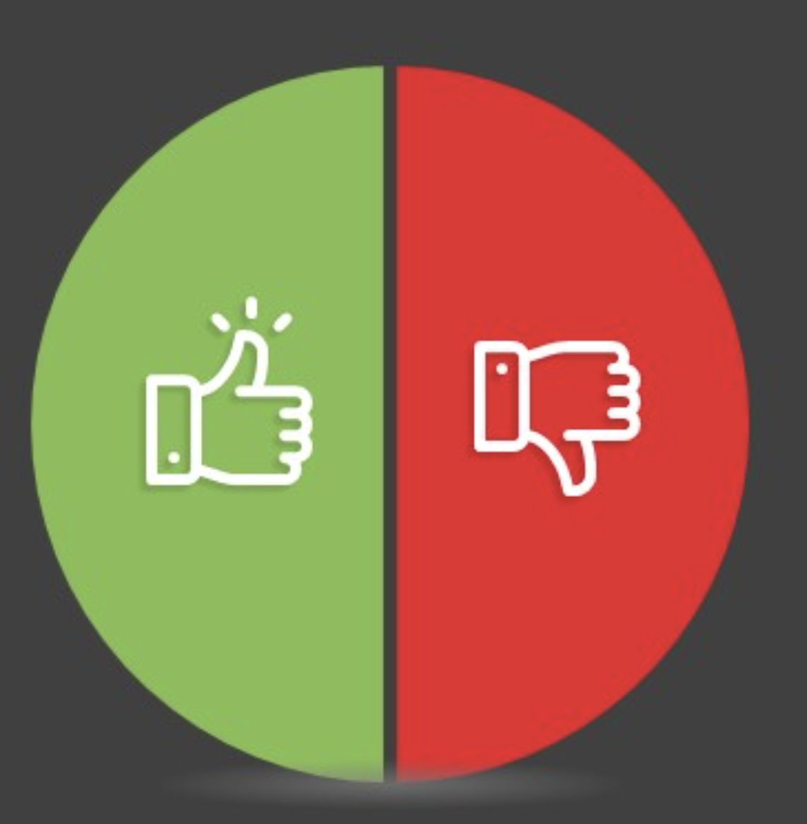
Don’t wait until the research is completed to engage with stakeholders.
1
Research responds to a specific problem identified by stakeholders and study is jointly conceptualized with buy-in secured
“X is a hot topic in the field. We should do a study on it." OR
“We've published a report on X.
We need to engage with policymakers now."
Evidence impact is well-defined and planned for, with practical and useful results for evidence users.
"We hope this research will be useful to someone (unspecified) at some time and will contribute generally to ending child marriage"​

Slide 5
“Our study underlines the importance of supporting research that meets locally-expressed needs and that is led by people embedded in the contexts in which results can be used. Supporting the involvement of health sector professionals in the design, conduct and interpretation of research appears to be an especially worthwhile investment.”

Slide 6


Strengthen capacity to increase evidence use
2
Even when there is motivation to use evidence to inform our work, there is a full range of skills and capacities needed to access, interpret and use information.
“These recommendations are not relevant to the context I work in!”
Where do I even begin finding the latest evidence?
So much info available,
so little time!
“RCTs, Compositional analyses.. My head hurts!”

Slide 7
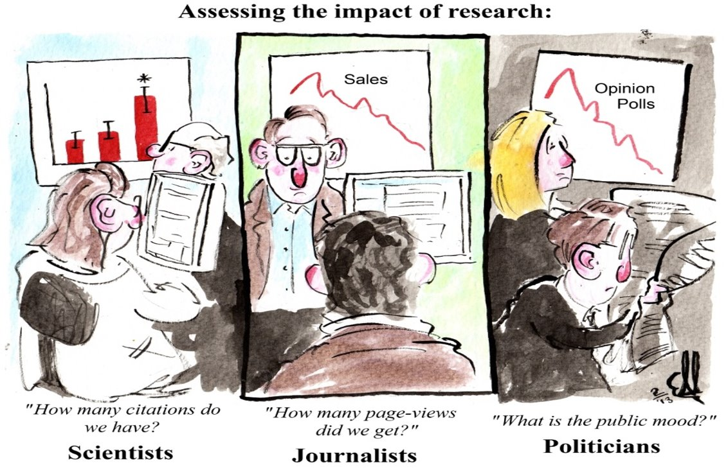

Monitor and measure uptake and impact
3
Few donors have an explicit definition of research impact
Conceptual impact
Capacity-building impact
Instrumental impact

Slide 8
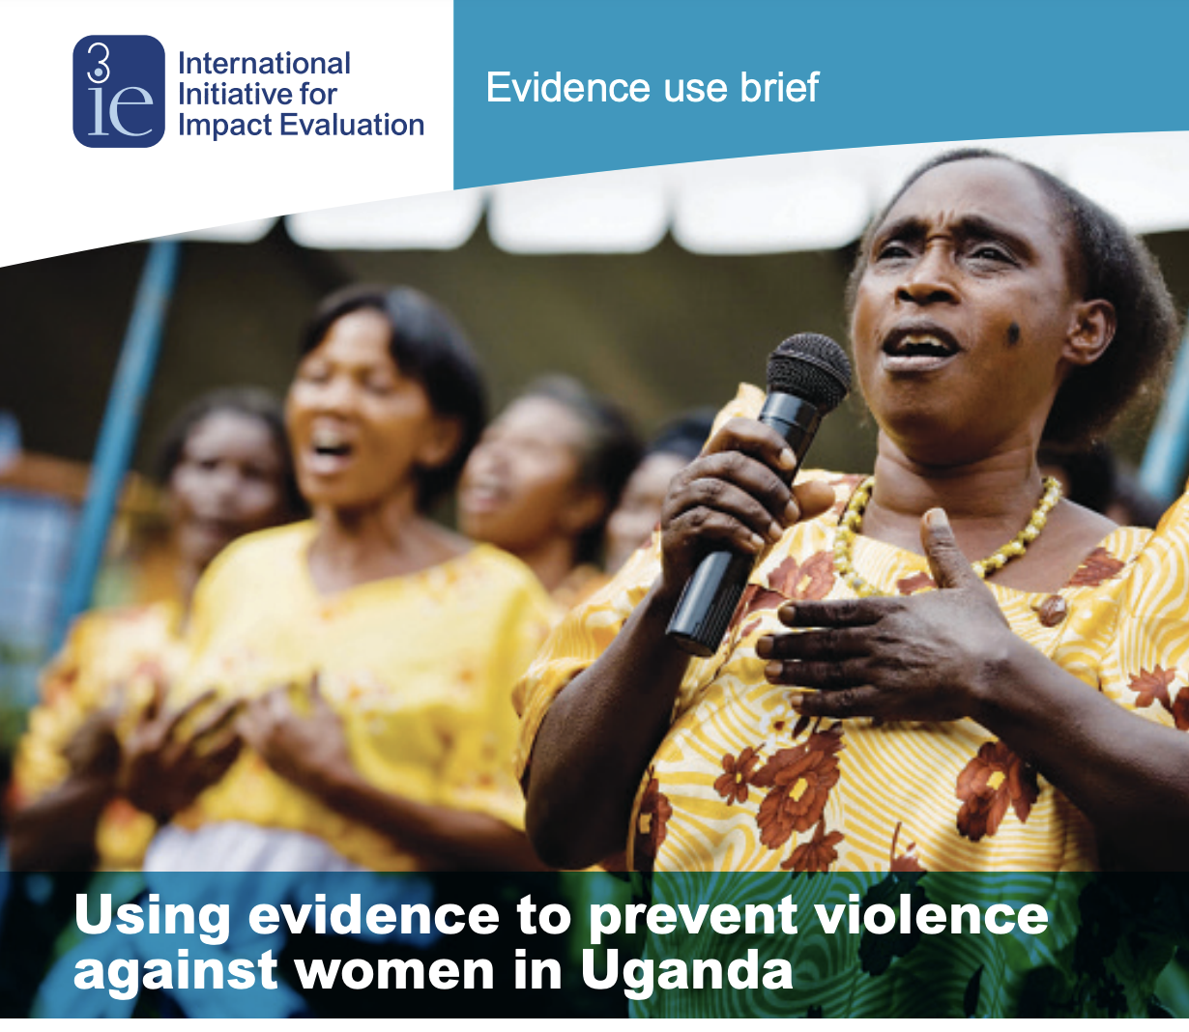
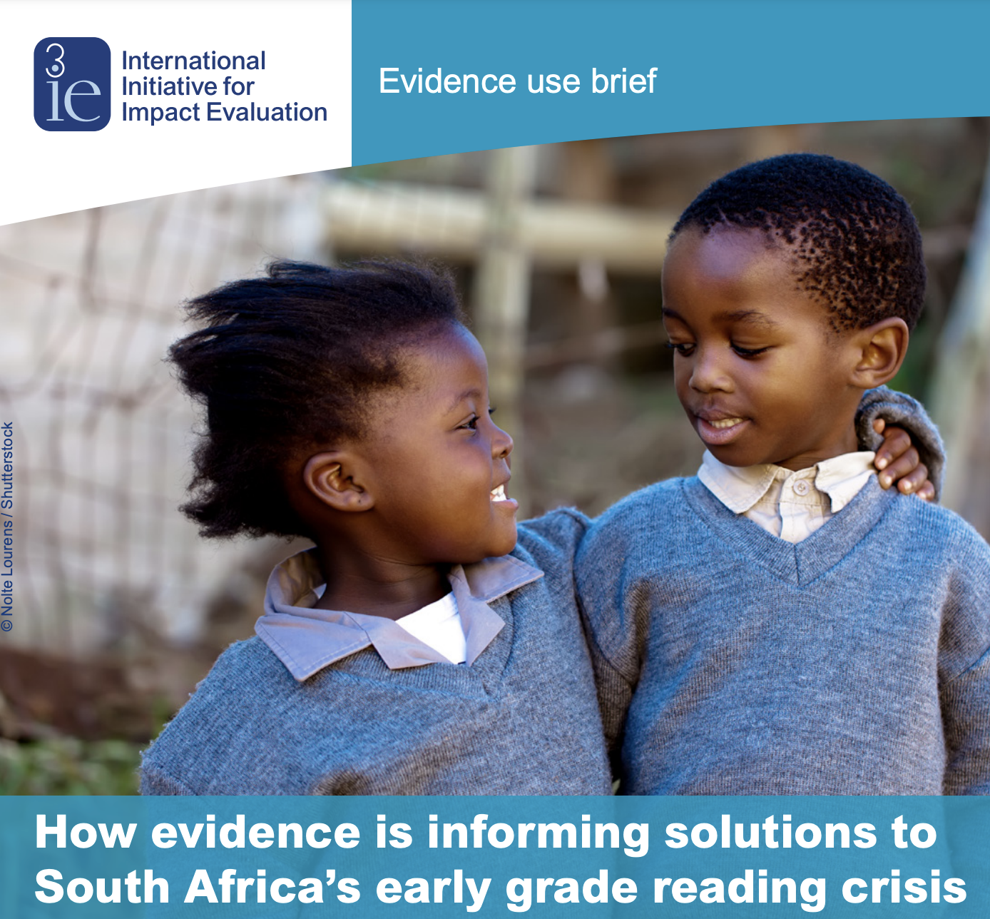
Document and share experiences of evidence use and impact
4

Slide 9
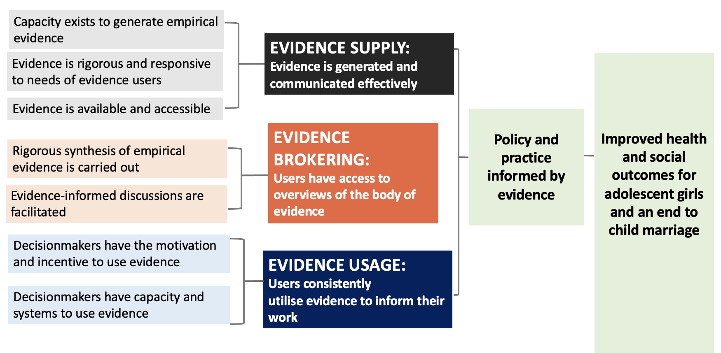
Always consider the bigger picture
5

Slide 10
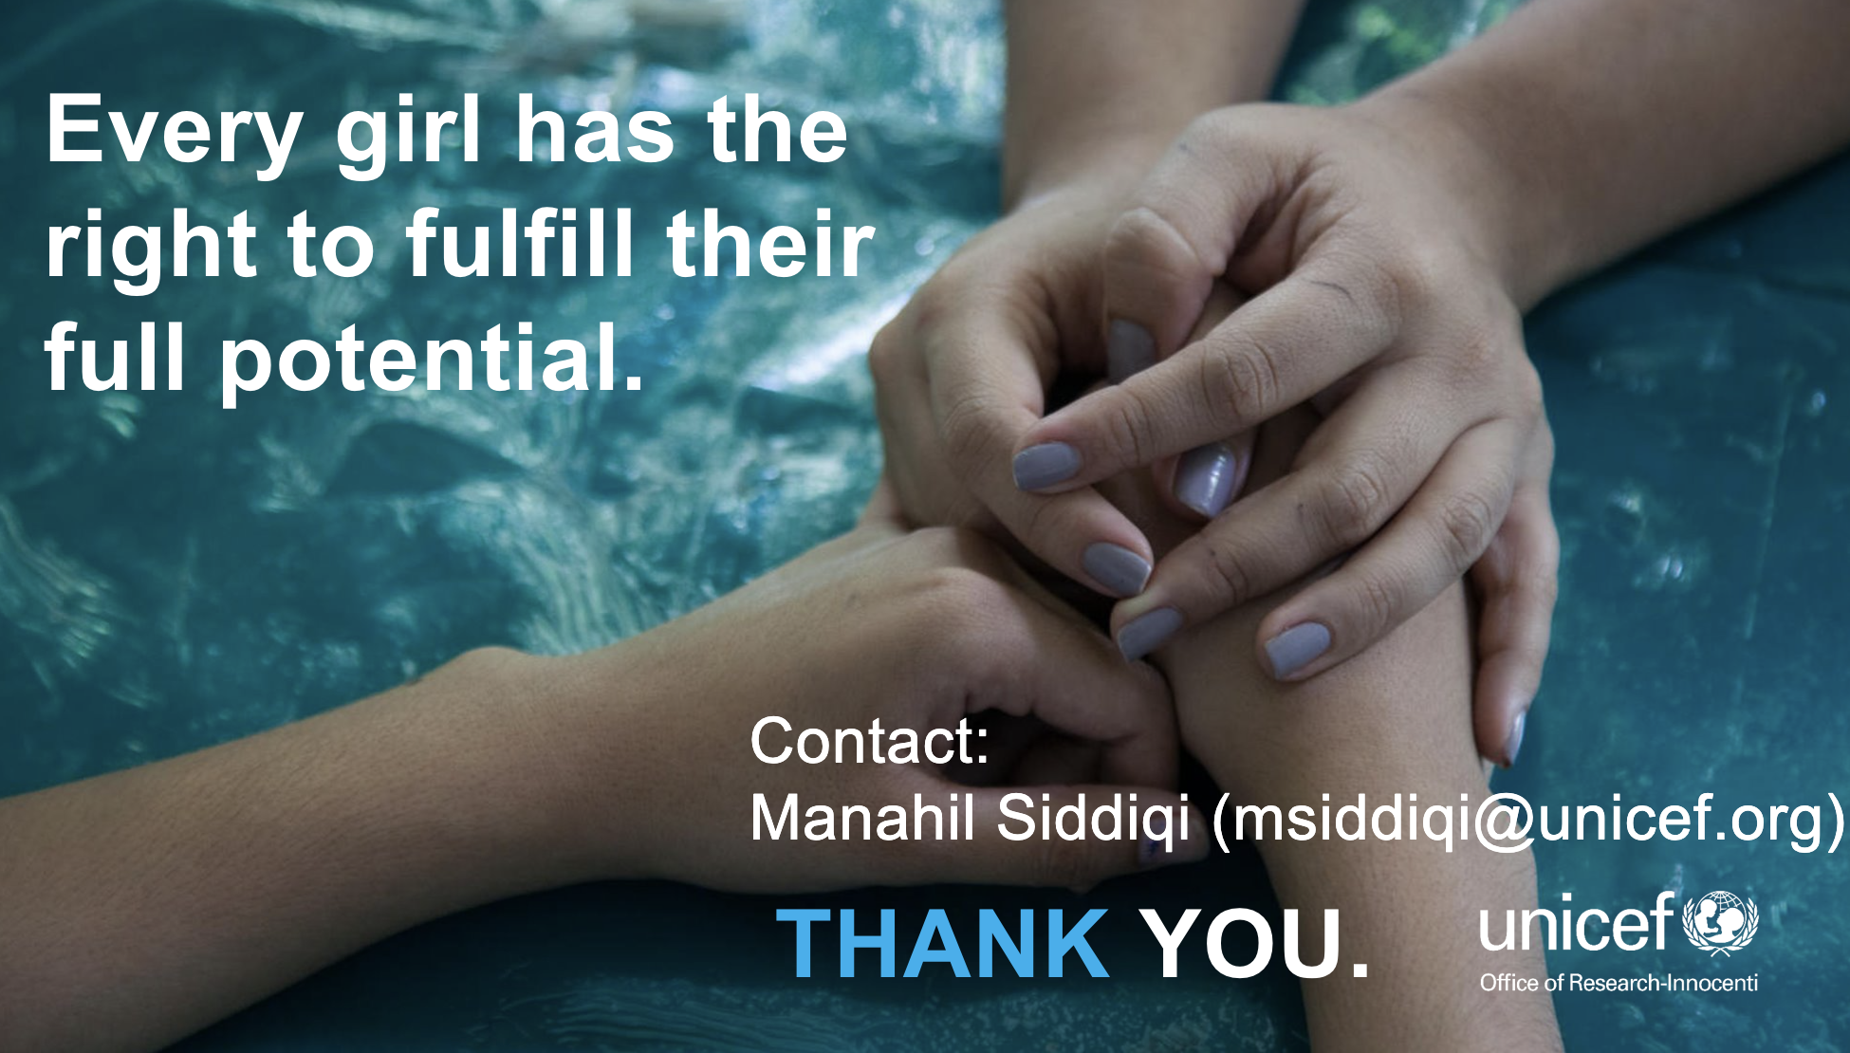

Every child has the right to live without violence.

