Slide 1
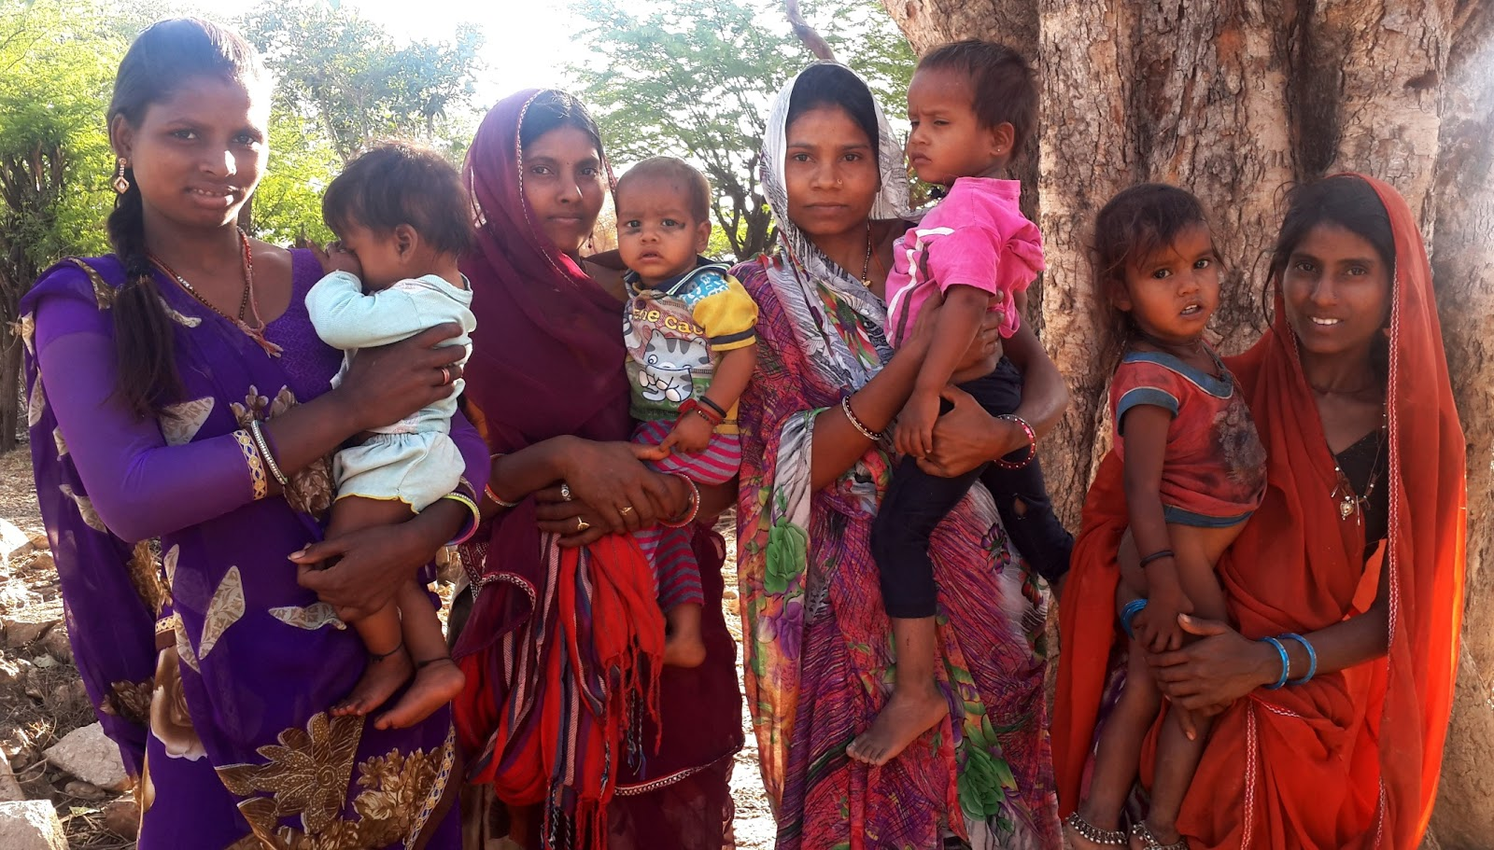

Invisible Population

Slide 2
Research on YMG
To explore experiences about marriage of girls and women (300 YMG and 300 Mother in laws of different castes)
To explore young men’s experiences and perspectives about marriages (50 young grooms)
To understand contextual such as community beliefs , attitudes and practies, other factors such as poverty that promote early marriage

Slide 3
Need for Collaboration
Missing from mainstream, policies, government schemes, economic empowerment etc
Limited to reproductive health
Need of sharing with organisations and understand their status in different states
What About Us! National workshop on Issues of Young Married Girls Organised with GNB and American Jewish World Service with 42 Participants
Organisations from different states working on different issues and communities were able to articulate the need to work with young married girls as a separate constituency
Shared different strategies to work with YMGs, their challenges and solutions

Slide 4
Way Forward
Create a network and support system
Discuss at international platforms with diverse stakeholders ranging from practitioners from the grassroots to national to international levels; civil societies, coalitions; government and; donors recognise and respond to the specific needs of young married girls
Keep discussing innovations, data, successes, learnings and have virtual sessions.
Emphasize on working with Couples

